Slide 1









Tools used for CI & CD

Slide 2
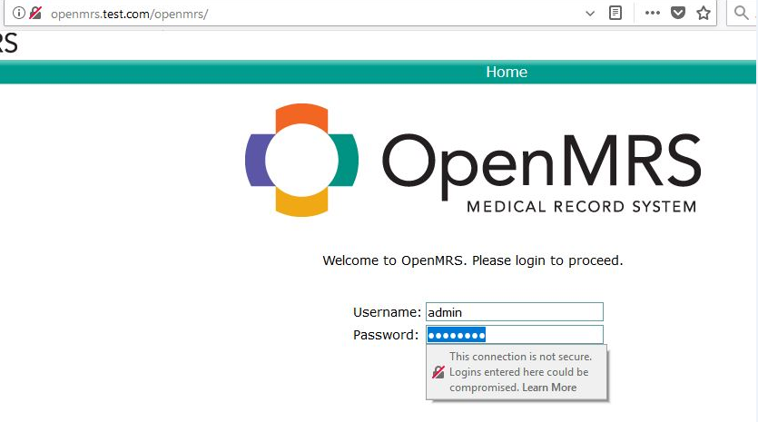
Real world Production application – We are going to do Build – Compile – Test – Packaging and deploy.

Slide 3
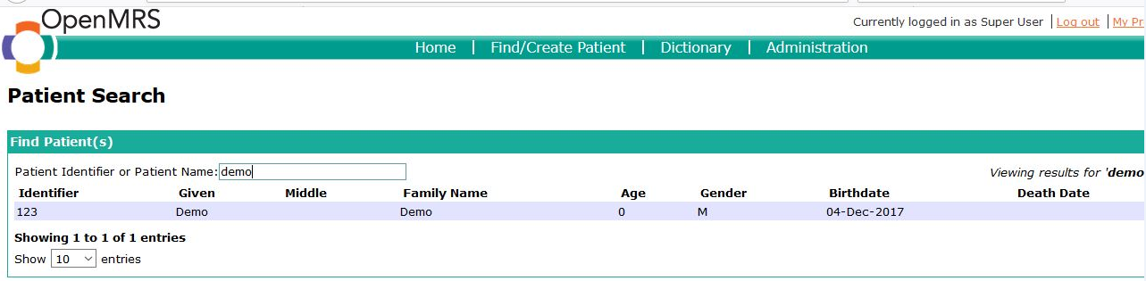
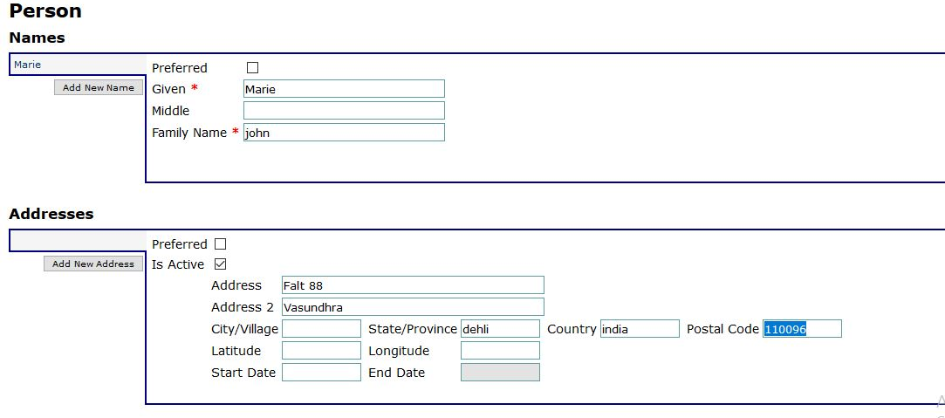
.

Slide 4
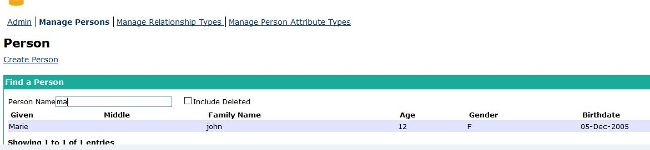
.

Slide 5
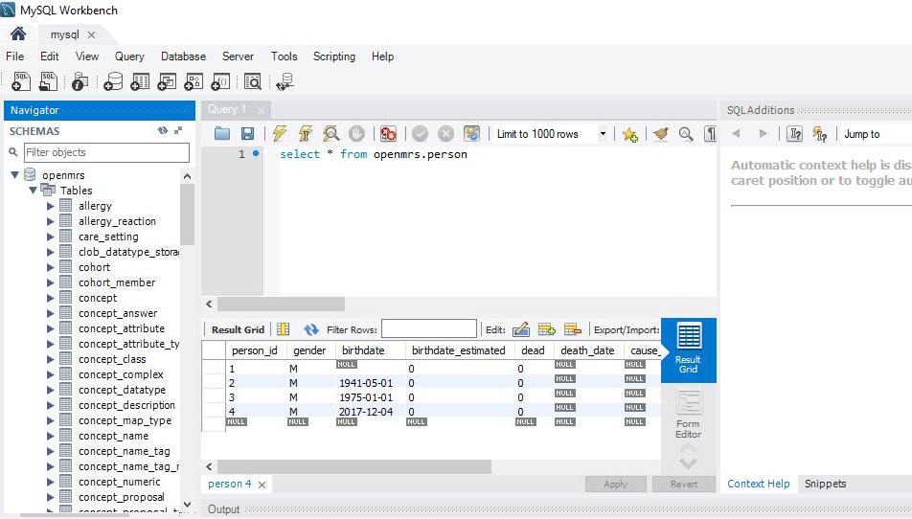
Real world Production application – MySQL DB as backend

Slide 6
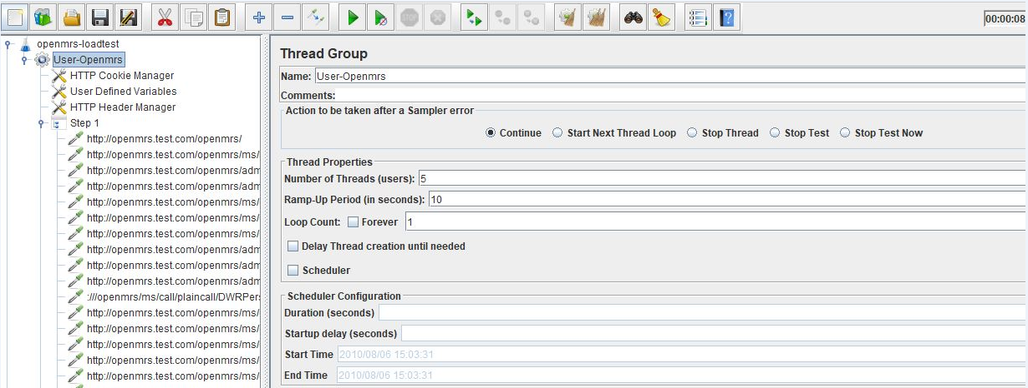
Jmeter – Application Performance test

Slide 7
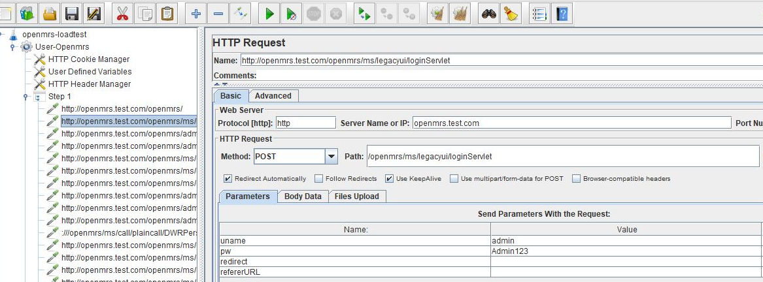
Jmeter – Application Performance test

Slide 8
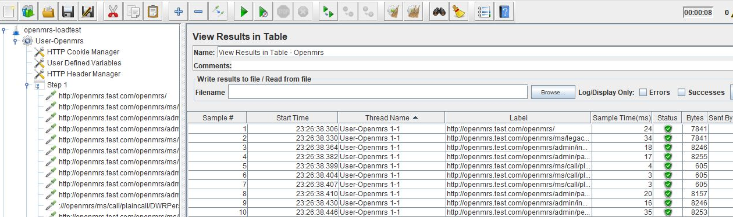
Jmeter – Application Performance test

Slide 9
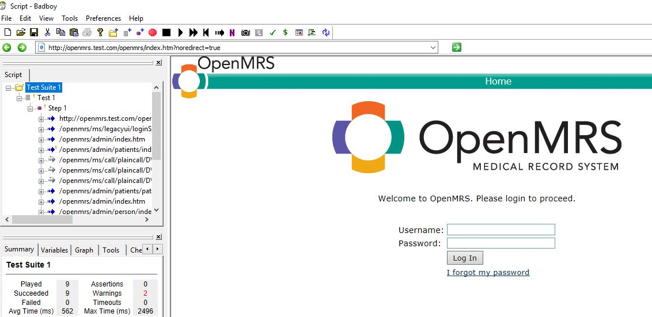
BadBoy – Click Stream generator for Jmeter

Slide 10
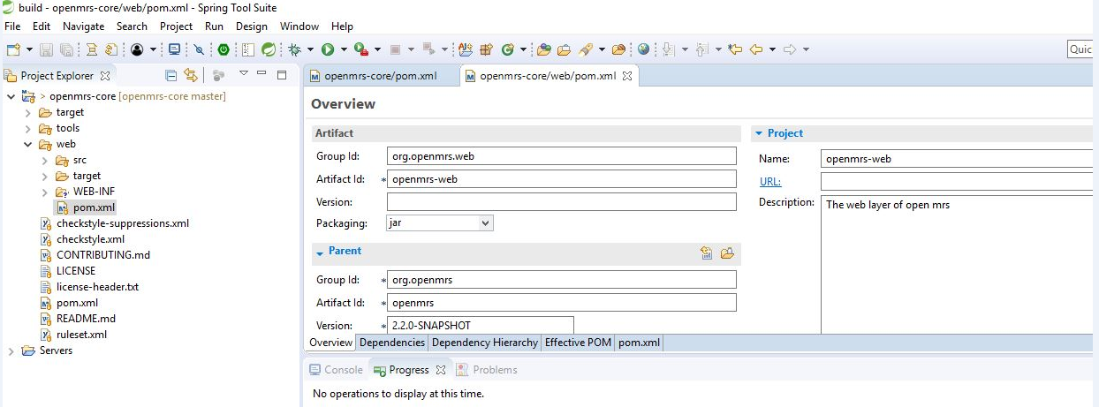
STS – JSP Project template suite

Slide 11
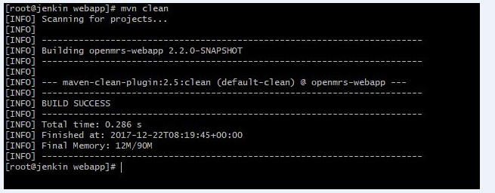
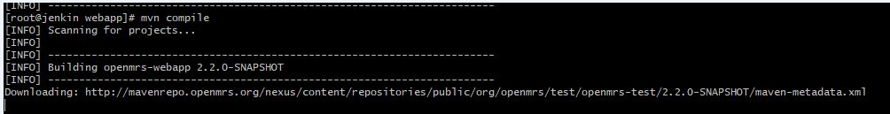
Manual Packing process - Maven

Slide 12
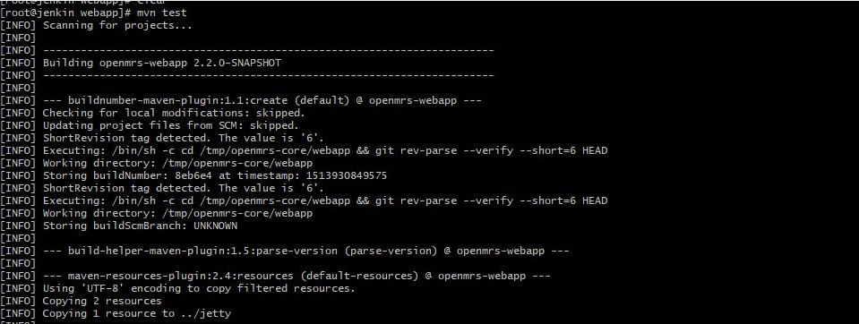
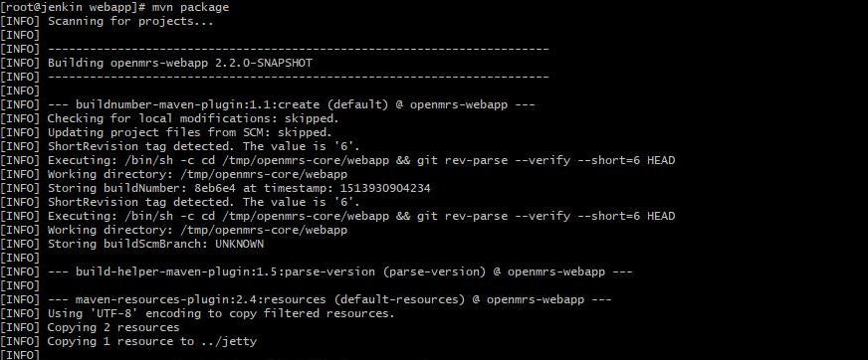
Manual Packing process - Maven

Slide 13
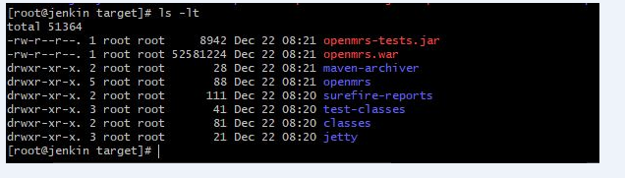
Manual Packing process - Maven

Slide 14
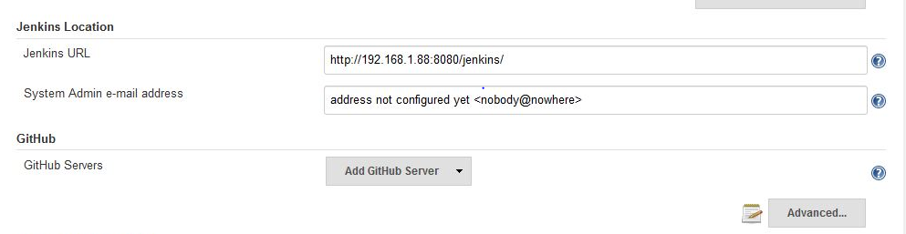
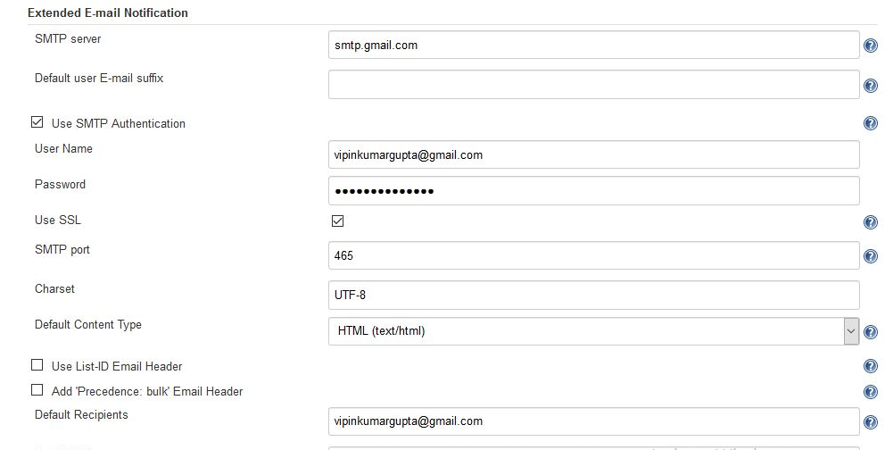
Jenkins Common configuration

Slide 15
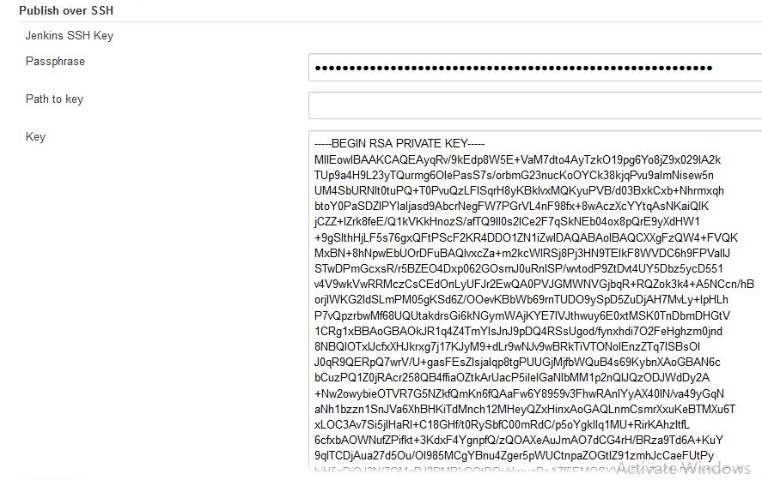
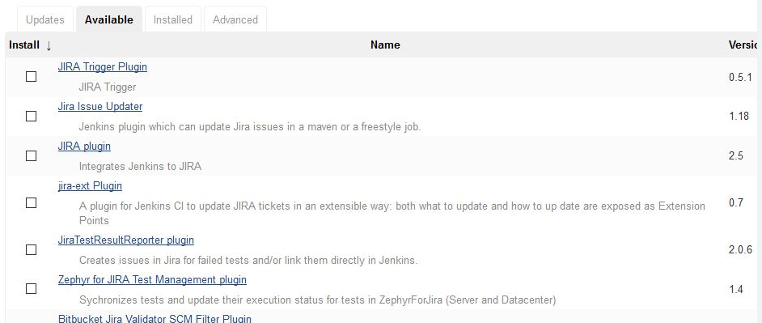
Jenkins Common configuration

Slide 16
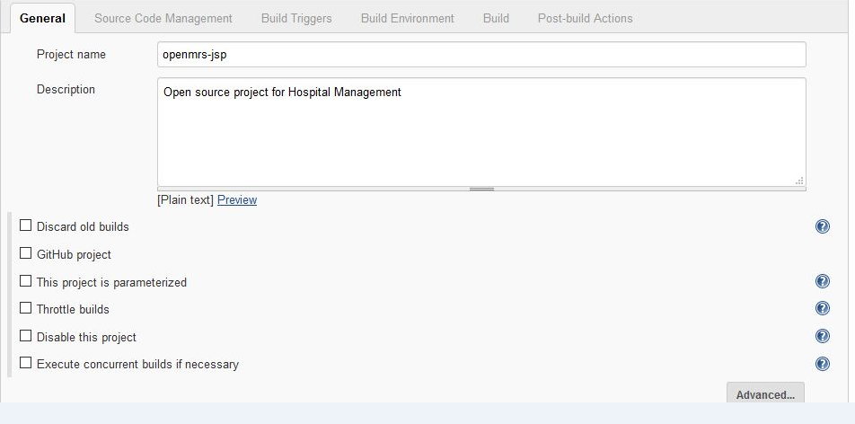
Jenkins – Classic systyle for build

Slide 17
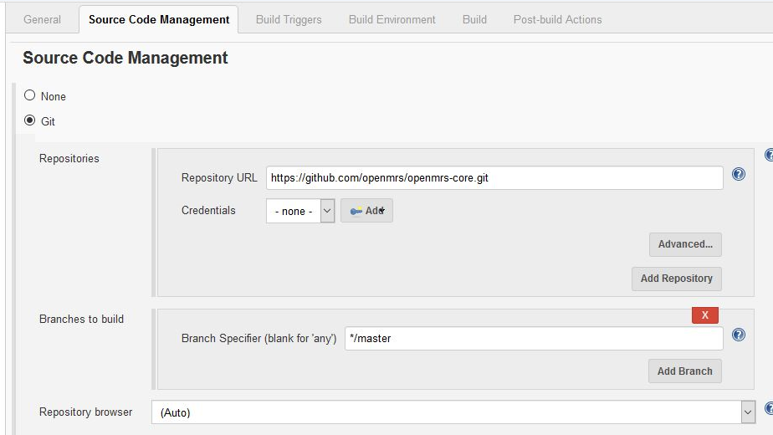
Jenkins – Classic systyle for build

Slide 18
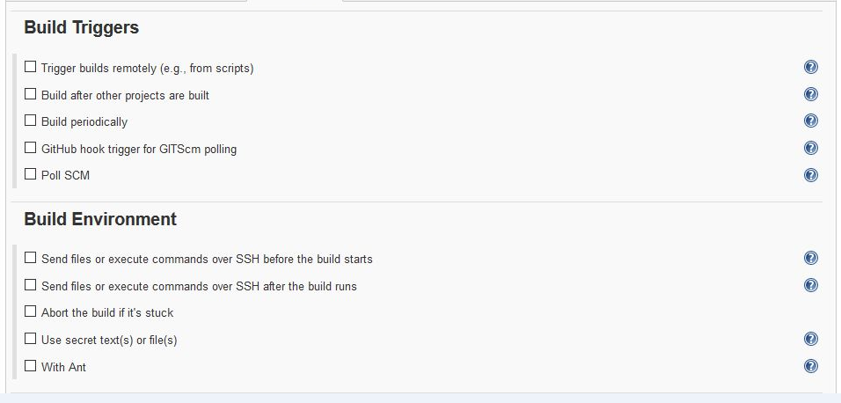
Jenkins – Classic systyle for build

Slide 19
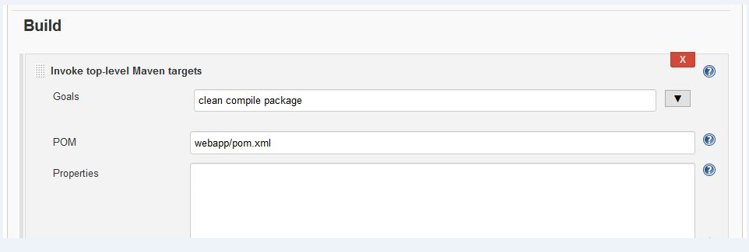
Jenkins – Classic systyle for build

Slide 20
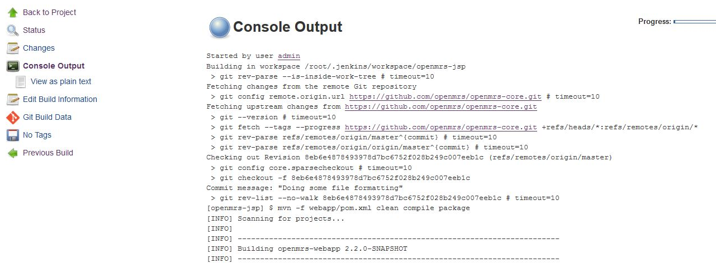
Jenkins – Classic systyle for build

Slide 21
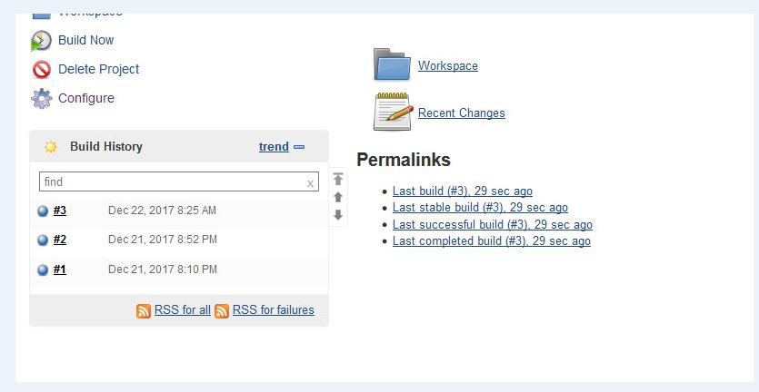
Jenkins – Classic systyle for build

Slide 22
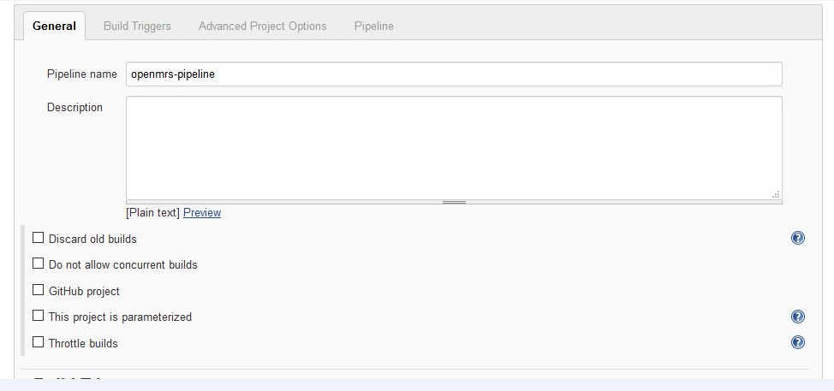
Jenkins – Pipeline systyle for build

Slide 23
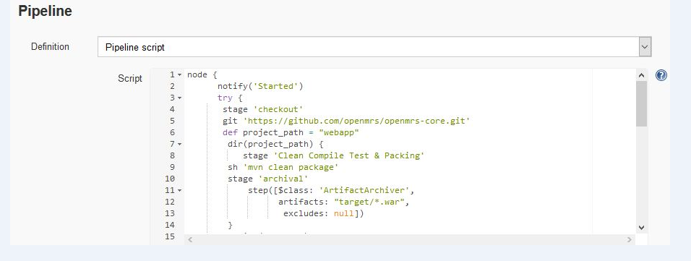
Jenkins – Pipeline systyle for build

Slide 24
node { notify('Started') try { stage 'checkout' git 'https://github.com/openmrs/openmrs-core.git' def project_path = "webapp" dir(project_path) { stage 'Clean Compile Test & Packing' sh 'mvn clean package' stage 'archival' step([$class: 'ArtifactArchiver', artifacts: "target/*.war", excludes: null]) } notify('Sucess') stage 'deloyment' sh 'ssh root@192.168.1.89 rm -f /opt/openmrs/openmrs.war' sh 'scp /root/.jenkins/workspace/openmrs-pipeline/webapp/target/openmrs.war root@192.168.1.89:/opt/openmrs/' } catch (err) { notify("Error ${err}") CurrentBuid.result = 'FAILURE' } } def notify(status){ emailext ( to: "vipinkumargupta@gmail.com", subject: "${status}: Job '${env.JOB_NAME} [${env.BUILD_NUMBER}]'", body: """<p>${status}: Job '${env.JOB_NAME} [${env.BUILD_NUMBER}]':</p> <p>Check console output at <a href='${env.BUILD_URL}'>${env.JOB_NAME} [${env.BUILD_NUMBER}]</a></p>""", ) }

Slide 25
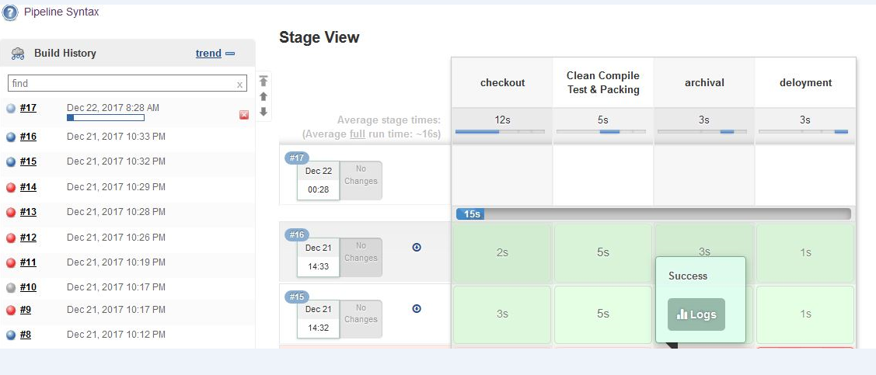
Jenkins – Pipeline systyle for build

Slide 26
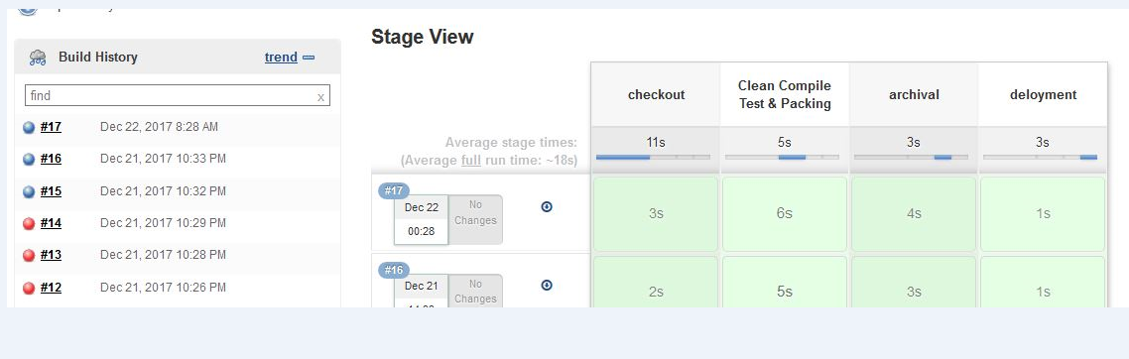
Jenkins – Pipeline systyle for build

Slide 27
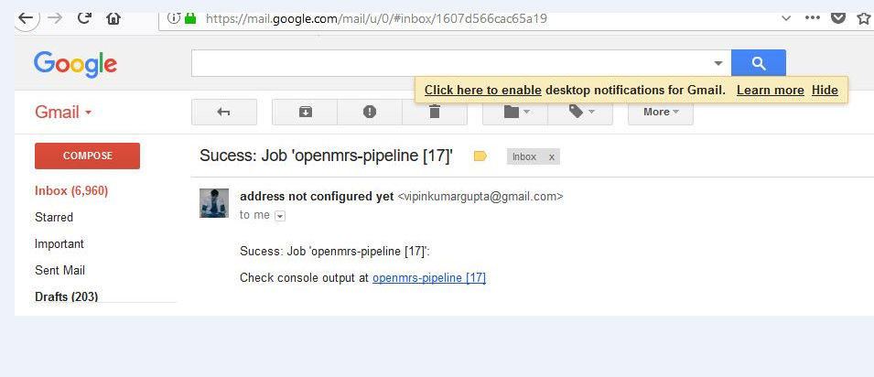
Jenkins – Pipeline systyle for build

Slide 28
Thank You

